Slide 1


Slide 2
What is it?
An algorithmic programming /problem solving contest
The oldest, largest, and most prestigious programming contest in the world.

Slide 3



Importance
Given its high competitiveness, the LCPC has become an attractive forum for the recruitment of the most talented students in the country.
Notes:
Participants not only will have the chance to get job in the best companies in Lebanon, but also in the best companies worldwide

Slide 4
Importance
Google makes 13 interviews before accepting a new employee. Employees who participated in the competition only make 3 interviews
Students could become trainers and train school students to reach ICPC.

Slide 5
For whom is this competition?
For every person who really wants to reach high positions in life.
Starts from zero level to reach high levels of knowledge.
It needs training.

Slide 6
Competition
4-World Finals(ICPC)
3-Championship(ACPC)
2-Regional(LCPC)
1-Qualifiers(local contest)

Slide 7
Training
Why?
Improve your problem solving skills
Improve your programming skills
Group work
Time management

Slide 8
Training
Requirements:
Dedication
Responsibility
Practice
Visual studio or any other equivalent IDE with C++ installed

Slide 9
Training
1 day per week at first as team training
At least 4 to 5 hours per week individual training
Understanding and analyzing the problems well before starting
Solve problems individually then do analysis of the solution

Slide 10
Learning Outcomes
Basic and Advanced coding skills
Variables, loops, conditions
Data structures and Algorithms
Code optimizing
Problem analysis and solving

Slide 11
How does the competition work?
Teams of 3 will be given a set of 8 or more real-world problems to solve in 5 hours on a single competition.
Only 1 pc is given for each team
It is based on competitive learning

Slide 12
Sample ICPC Problem
Problem statement: describing the problem and what output is to be generated.
Input: Make sure that you read this section with complete attention as missing out any minor detail may land you in wrong answer zone.
Output: Just like above, this one also should be read carefully.
Constraints: These can include constraints on input, time, memory, code size, etc.
Time limit: See if your algorithm can work in this range. If not, time to change it!
Memory limit: If you are fond of allocating memory for every small thing, it’s a good time that you changed it.

Slide 13
Coding Languages & Environments
Languages:
C
C++
Java
Environments
Eclipse
INTELLIJ
LINUX G++
CODEBLOCKS

Slide 14
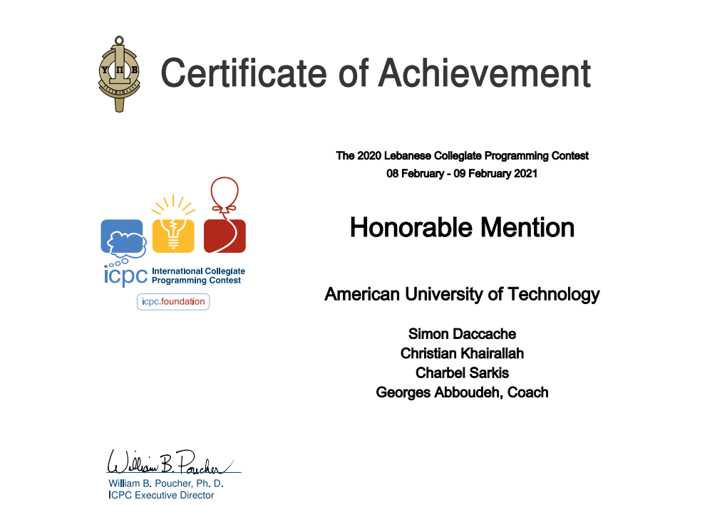
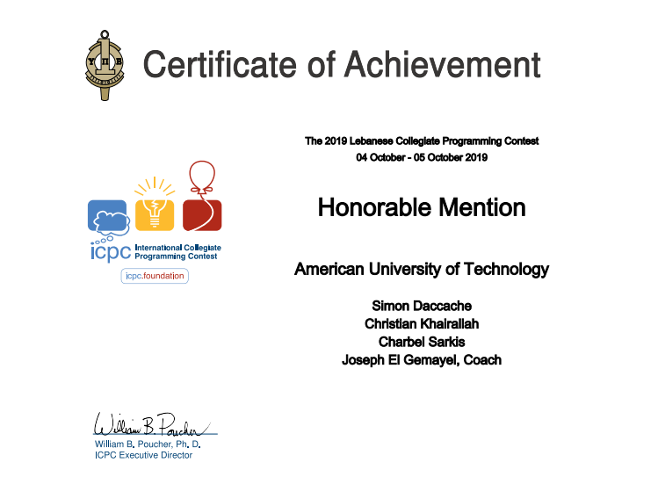
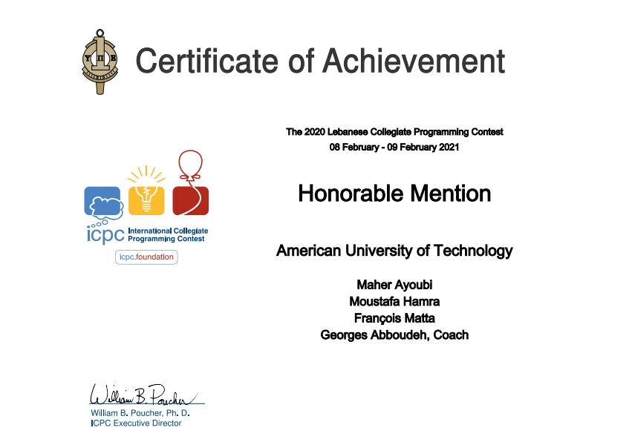
Testimonials

Slide 15
Next Meeting
Use of version control: GitHub
Basic coding
To Do List:
Create GitHub account
Install C++ on visual studio

Slide 16
Cout<<“THANK YOU”;
Cin>> question;

